Slide 1
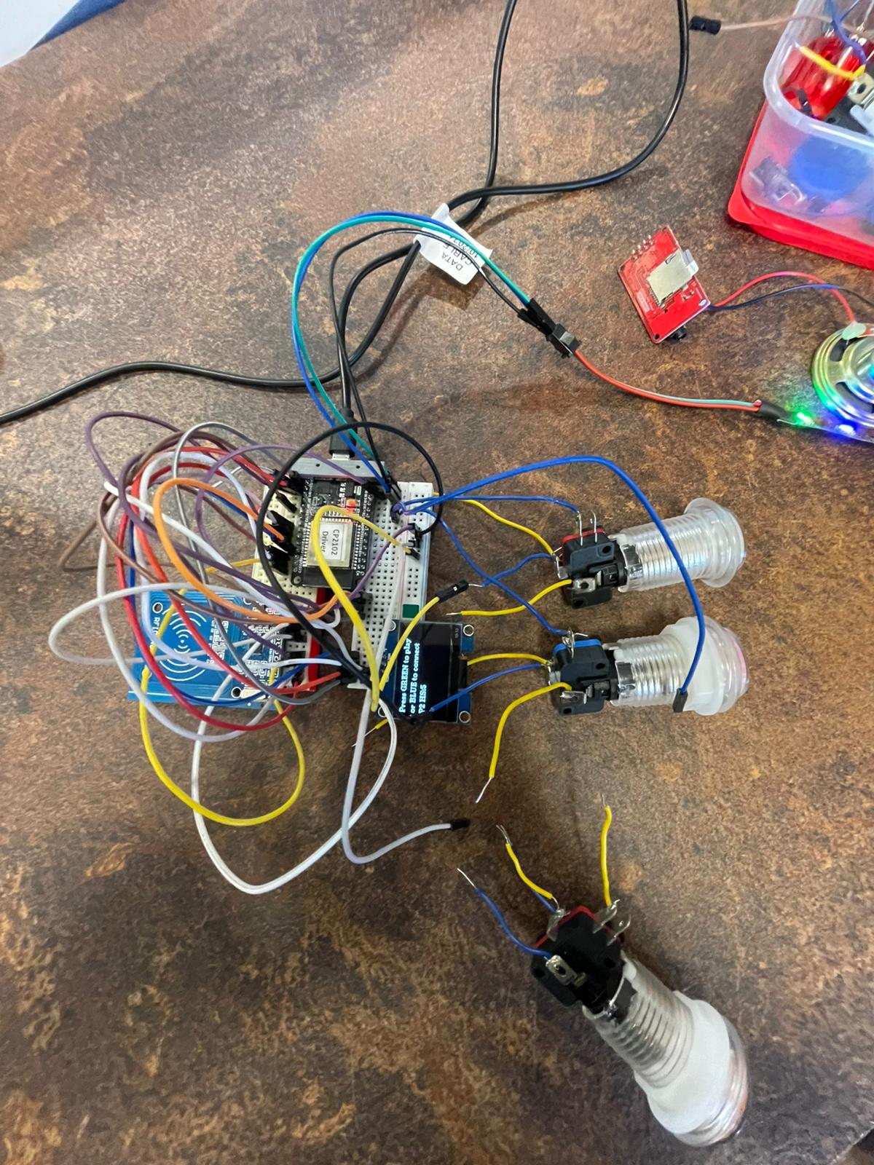
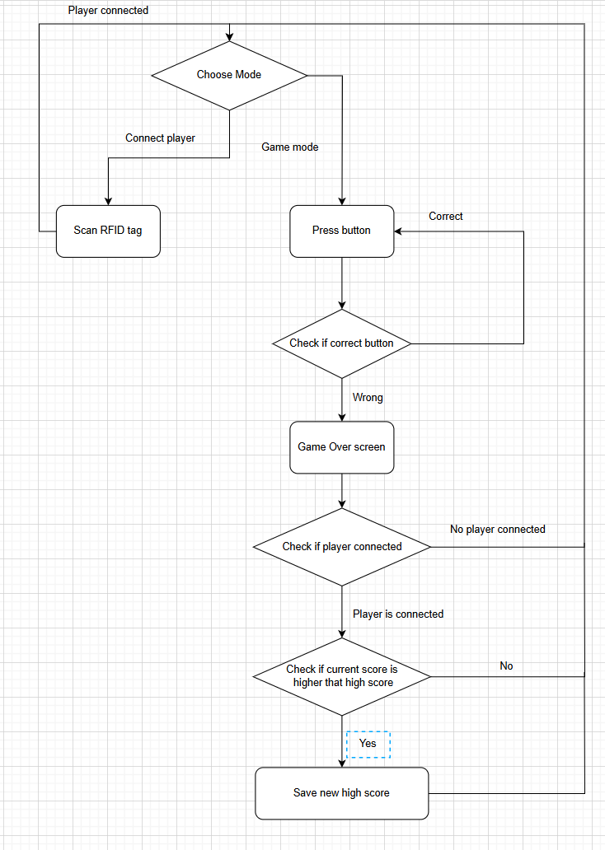
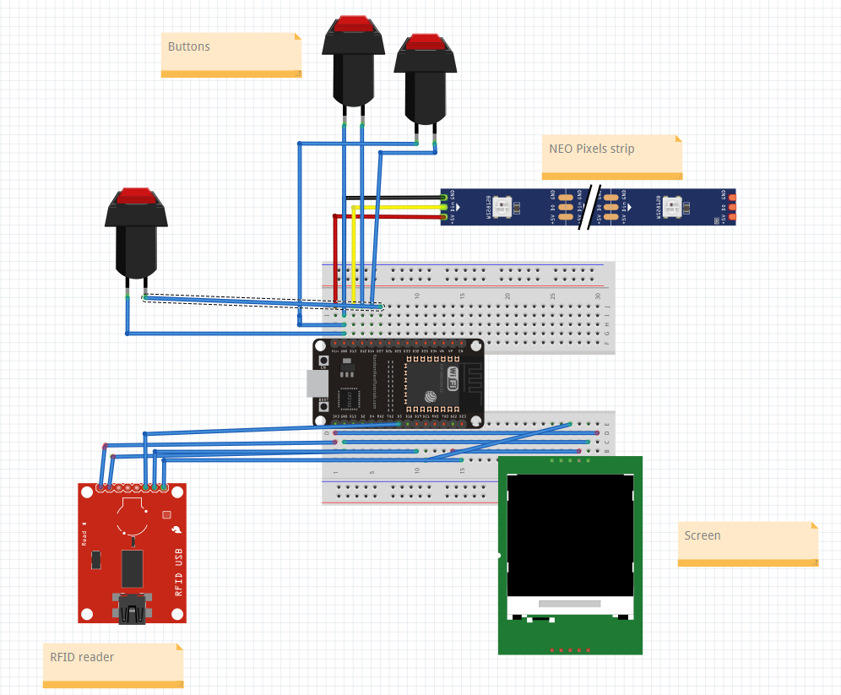
Rehabilitation game
A fast-paced game designed to test and improve your reaction time and memory; the project provides multiple Interactive games in one Board.
Sound-based game with colors.
Memory game
Multiple player profiles and high scores
Speaker and screen: interact with the current button to press ,also interacts with game Win or lose.
PushButton: the user have 5 to interact with them.
RFID reader reads tags to connect to different player profiles
LEDS changes colors randomly .
The Board: includes three PushButtons , NeoPixel Strip , Switch , Speaker, screen, RFID reader
Wiring Diagram
proccess Diagram
Team: Ramy Abu Tareef, Razi Hussein, Jamilih Kherbawy.
Lecturer: Itai Dabran, Instructors: Tom Sofer, Maher Bitar.

